Slide 1

Introduction to Reverse Engineering
Download reverse files in the discord

Slide 2
Goals
Learn what reverse engineering is
Learn basic tools for reverse engineering
See what basic disassembled code looks like
Try some reverse engineering problems

Slide 3
Helpful Courses
1) CPSC 355 (Computing Machinery)
2) CPSC 527 (Computer viruses and malware)

Slide 4
Tools
GDB
cutter

Slide 5
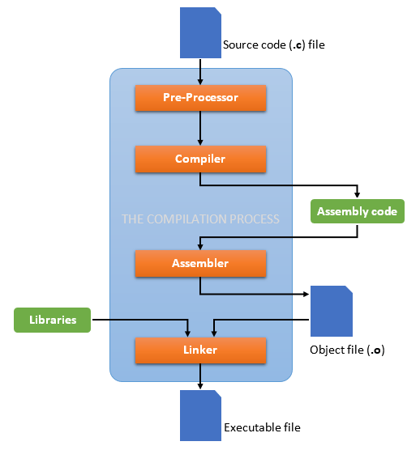
Notes:
- Last time we saw how to take C files and manipulate them
We also saw how they get turned into assembly code
Now we take a look at the Executable file (the binary)
Disassembly (turn it back into assembly code)
Decompile (turn it back into a c-program)

Slide 6
Binary file
./reverse0
Strings reverse0
Xxd reverse0
“vim reverse0”
“gdb reverse0”
Open reverse0 in cutter

Slide 7
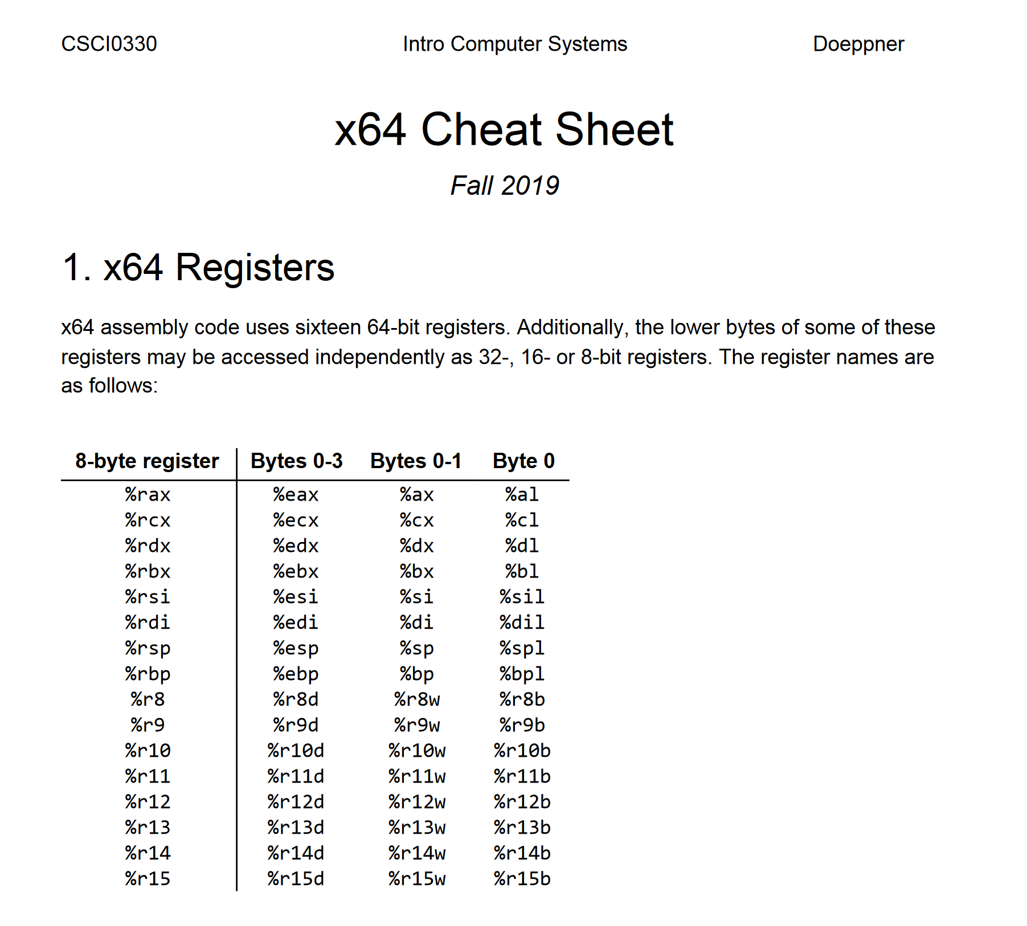
https://cs.brown.edu/courses/cs033/docs/guides/x64_cheatsheet.pdf
(in discord under “workshop materials”)

Slide 8
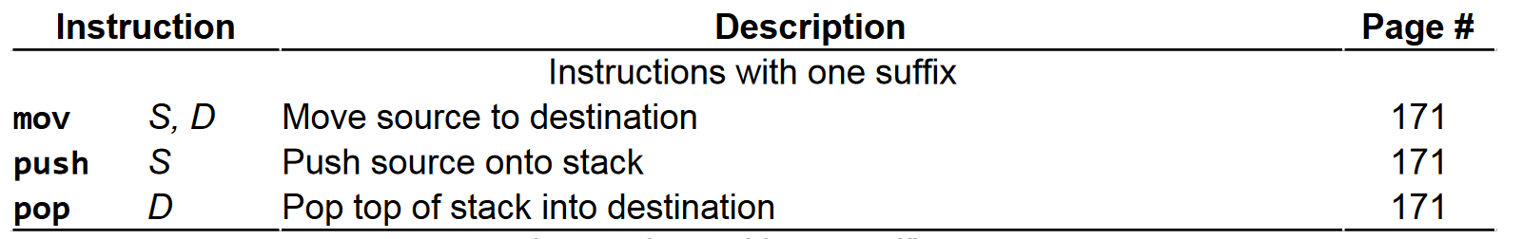
Reverse0.c

Slide 9
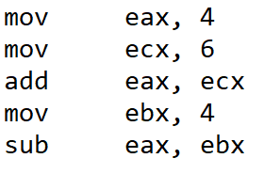
Reverse0.c

Slide 10
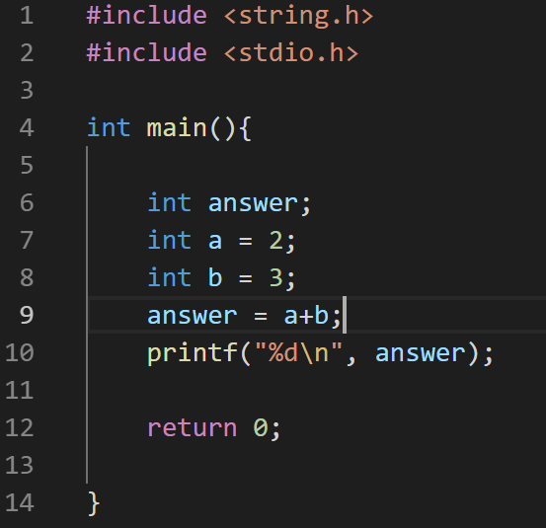
Reverse0.c

Slide 11
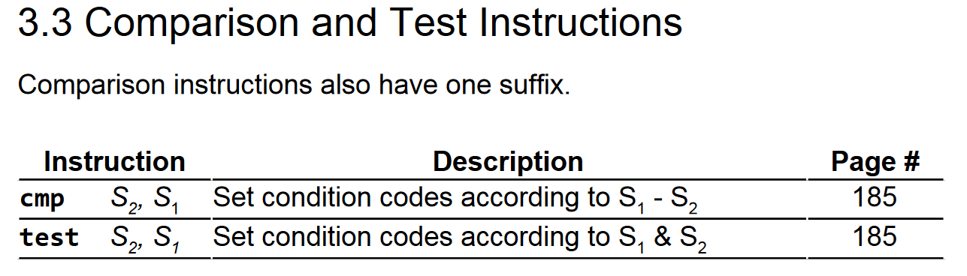
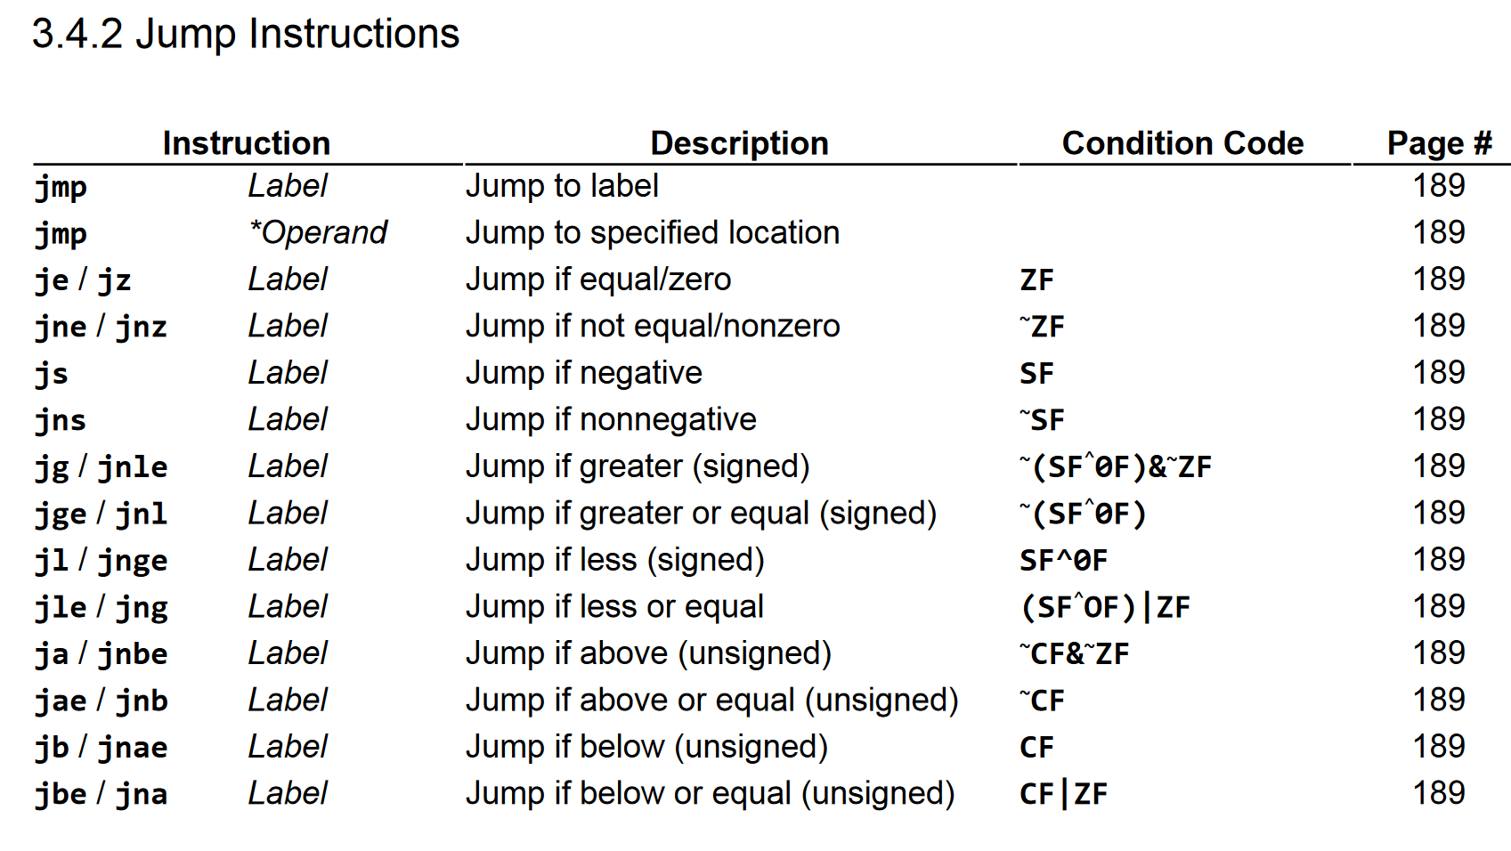
Reverse1.c

Slide 12
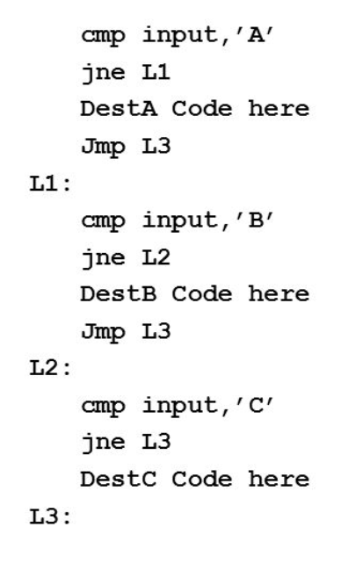
Reverse1.c

Slide 13
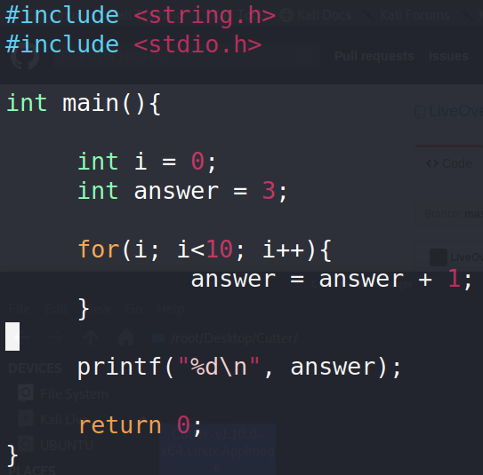
Reverse1.c

Slide 14
Reverse1.c

Slide 15
Reverse2 - Tools
strings
xxd

Slide 16
Control Graphs - reverse2

Slide 17
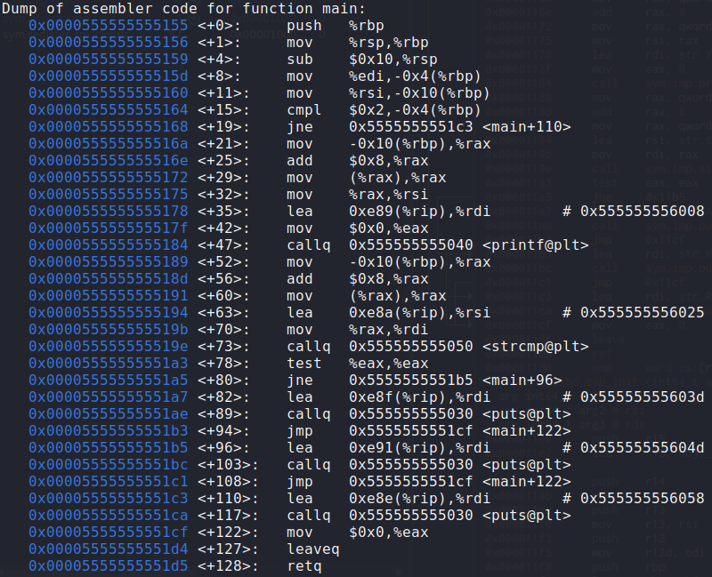
Reverse2.c

Slide 18
reversechallenge
Worth 275 points!
Challenging
Multiple ways to get the flag

Slide 19
Rest of workshop
Reversechallenge
Picoctf 2018 reverse challenges
Cookbook & feedback at 7:15

